Slide 1


TRAVEL TOUR
TRAVEL TOUR

Slide 2


1
2
3
ACKNOWLEDGE
INTRODUCTION
PROBLEM DEFININITION
CONTENT
4
5
6
CUSTOMER REQUIREMENT SPECIFICATIONS
HARDWARE/ SOFTWARE REQUIREMENT
VISITOR USE CASE

Slide 3
7
8
ADMIN USE CASE
DFD
CONTENT
9
10
11
SITE MAP
ERD
TASK SHEET

Slide 4

ACKNOWLEDGE
Grateful for contributions to our successful software engineering project. Thanks to Mr. Danh, our team, and technologies like PHP and Laravel, shaping a dynamic application. This collaborative journey cultivated teamwork, skills, and camaraderie, influencing our future endeavors.

Slide 5

INTRODUCTION
Excited to present our software engineering project – a comprehensive tour and travel website. Our team strives to create a visually appealing and technologically robust platform for seamless exploration, booking, and adventure planning. Join us on this technological journey that enhances wanderlust.

Slide 6


PROBLEM DEFINITION
Addressing travel struggles with a simple website using PHP, Laravel, and more. Current methods are confusing; our goal is to simplify tour booking, offering an efficient, user-friendly experience. Let's make travel planning easier for everyone.
TOUR LIST
PLACES

Slide 7


CUSTOMER REQUIREMENT SPECIFICATIONS
USER
ADMIN

Slide 8
INPUT:
PROCESS:
Forms and Text Fields
Buttons and Links
Dropdowns and Selections
Checkboxes and Radio Buttons
Uploads
Form Submission (Validation and Verification)
Dynamic Updates
Backend Processing (PHP, Laravel)
Client-Side Scripting (JavaScript)
OUTPUT:
USER
Displaying Results
Error Messages
Confirmation Messages
Visual Changes

Slide 9
INPUT:
PROCESS:
Login Credentials
Configuration Settings
Data Upload
Authentication
Authorization
Configuration Processing
Data Management
OUTPUT:
ADDICTION ASPECTS:
Admin Dashboard
Error Messages
Activity Logs
System Status Updates
Confirmation Messages
Role Management
Security Measures
Notification System
Backup and Recovery
USER

Slide 10
Hardware:
Software:
Web Server:
Processor: Intel Core i3 or higher
Memory: 6 GB RAM or greater
Modem/ADSL Internet access required
Client:
Processor: Intel Core i3 or higher
Memory: 6 GB RAM or greater
Monitor: Super VGA (1024x768) or higher resolution
Modem/ADSL Internet access required
Server:
Web Server: XAMPP
Operating System: Windows 7 or later
Databases: MySQL
PHP - Laravel framework
Browser: Google Chrome version 35
Client:
Operating System: Windows 7 or higher
Browsers: Google Chrome, MS-Edge, Firefox
HARDWARE/
SOFTWARE REQUIREMENTS:

Slide 11
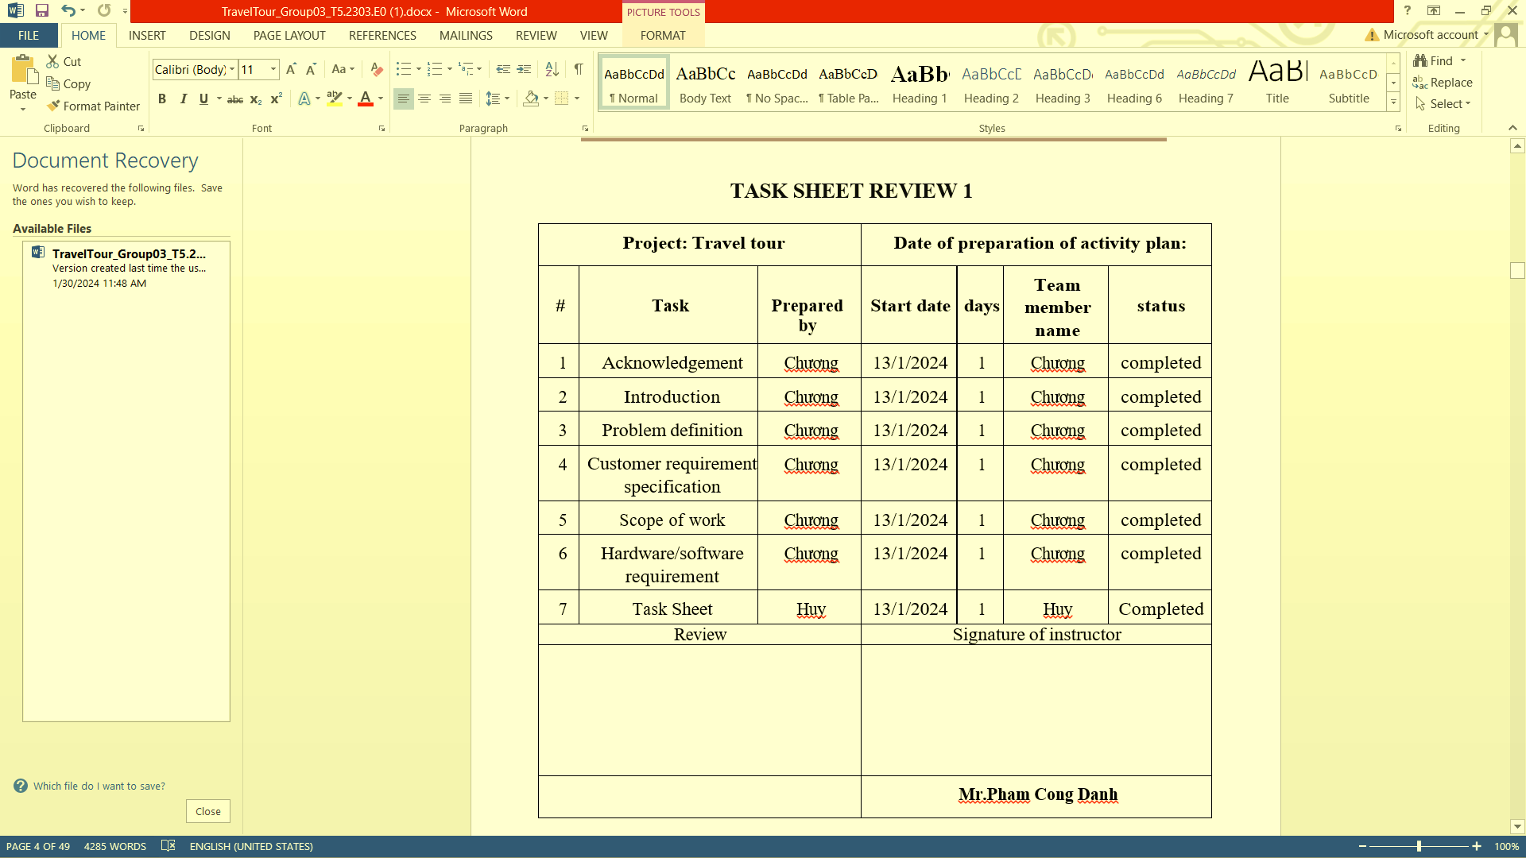
TASK SHEET
REVIEW 1

Slide 12

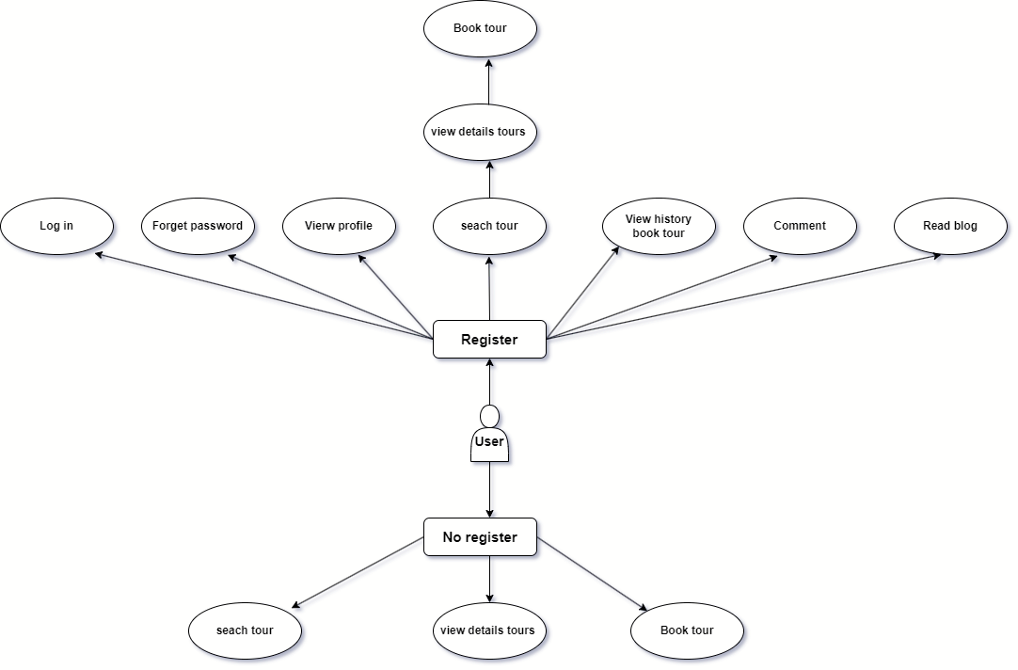

USER CASE

Slide 13

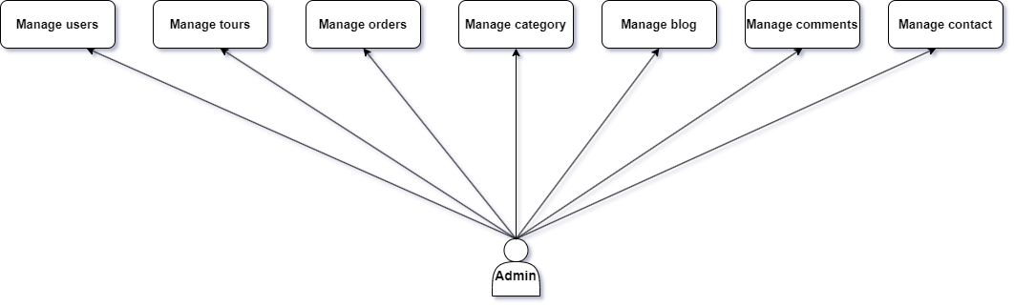

Slide 14
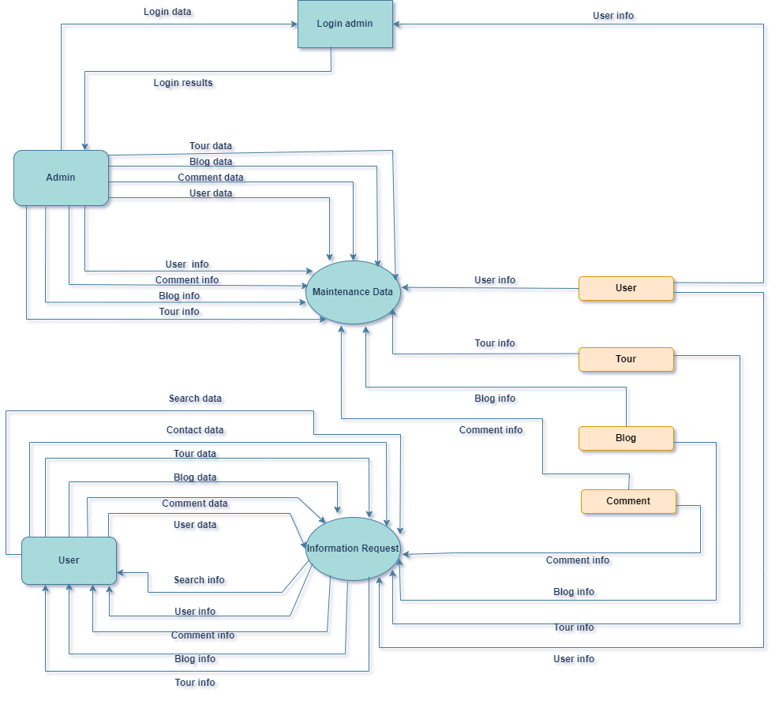
DFD

Slide 15
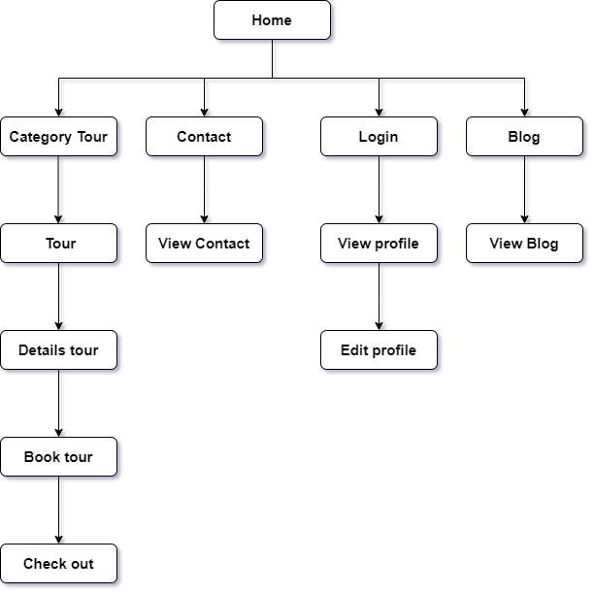

SITE MAP
USER

Slide 16

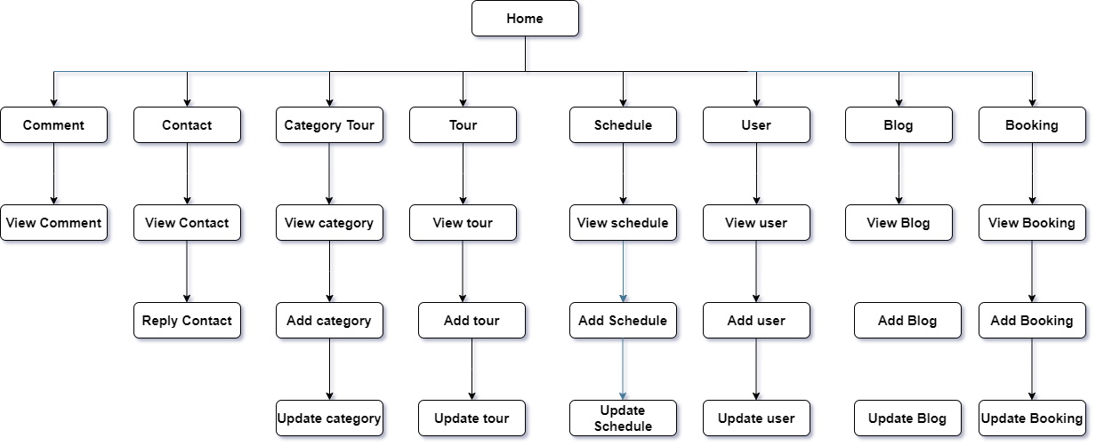

Slide 17


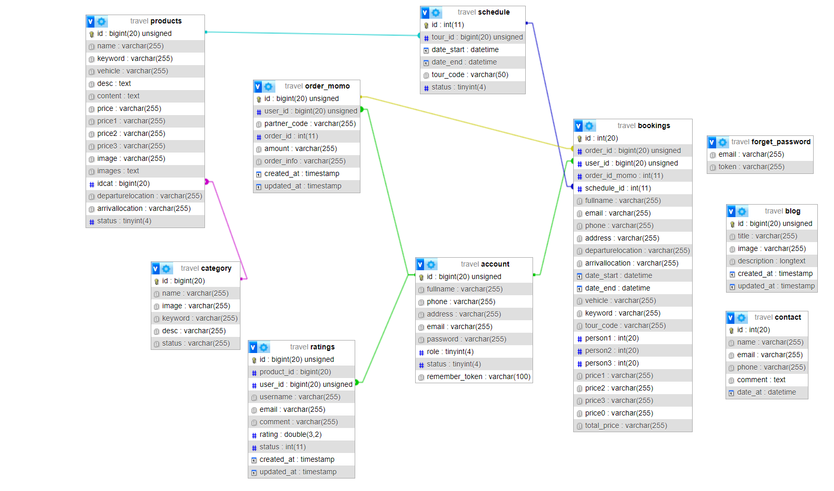


ERD

Slide 18
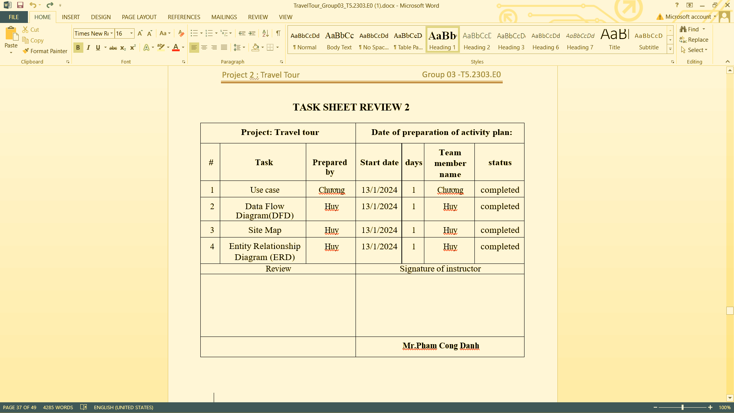
TASK SHEET
REVIEW 2

Slide 19
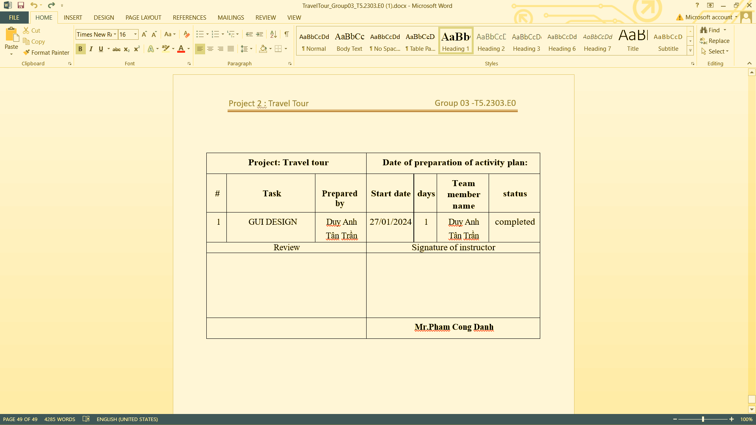
TASK SHEET
REVIEW 3

Slide 20
THANK YOU

